Slide 1
Skills Bootcamp Classroom Rules
Be on time: Just like in a physical classroom, it's important to be punctual for your online class. Log in to the virtual classroom a few minutes before the class starts.
Turn Cameras on: In order to maximise your learning studies show that being able to see your peers and your tutor being able to see you can increase motivations and retention, therefore we ask to keep your cameras on.
Attend all classes: In order to be successful in your bootcamp studies you need to attend all live sessions, therefore you should prioritise and make time for these sessions.
Avoid distractions: Turn off your phone notifications, close any other unnecessary tabs, and focus solely on the class.
Participate actively: It's important to be an active participant in the class. Ask questions, answer questions, and participate in discussions.
Use proper language and tone: Use respectful language and tone when communicating with your classmates and instructor. Avoid using slang or inappropriate language.
Respect others' opinions: Be respectful of others' opinions, even if they differ from your own. Avoid making negative comments or attacking others.
Follow the instructor's guidelines: Follow the instructor's guidelines, such as submitting assignments on time.
Be polite: Be polite and respectful to everyone in the class, including the instructor, classmates, and guest speakers.
Dress appropriately: Even though you are not in a physical classroom, it's important to dress appropriately. Dress as if you were going to a face-to-face class.
Use appropriate technology: Ensure that you have the necessary equipment, such as a reliable internet connection, a microphone, and a webcam, and that they are in good working condition.

Slide 2
Software Developer Bootcamp
Unit 1 – Introduction to Software Development
Week 3B

Slide 3
Learning Outcomes
Following this session, you should be able to:
Popular programming languages (e.g., Python, Java).
Breakdown the structure of a basic program.
Debug and troubleshoot the program.
Best practices for writing clean and efficient code.
Understand how to import functions into Python code.
Notes:
Today, we'll explore the fascinating world of software development, focusing on popular programming languages, understanding the architecture of a basic program, debugging techniques, and best practices for writing clean and efficient code.

Slide 4

Roll the dice!
Question .
Why do you use a dice in real-life games?
Notes:
Image source - https://pixabay.com/vectors/dice-games-play-1294902/

Slide 5
Roll the dice!
When you roll a dice by hand, the result is determined by many things such as:
Starting position
Friction
Gravity
Air resistance
The outcome of the resulting throw is therefore pretty random.
Notes:
Image source - https://pixabay.com/vectors/dice-games-play-1294902/

Slide 6

Roll the dice!
Starter activity
Question .
Where might you need to generate randomness in a computer game?
Notes:
Image source - https://pixabay.com/vectors/dice-games-play-1294902/

Slide 7
Roll the dice!
Any dice game
To play a game like rock, paper, scissors against a computer
To generate random words for a word guessing game

Slide 8
Make a prediction (think, pair, share)
1 2 3 4 | from random import randint number = randint(1,5) print(number)
Question .
What will be the output of print, when this program is executed?
number
randint(1,5)
It is not possible to know the output without executing the program
3

Slide 9
Make a prediction (think, pair, share)
Activity 1
1 2 3 4 | from random import randint number = randint(1,5) print(number)
Question .
What will be the output of print, when this program is executed?
number
randint(1,5)
It is not possible to know the output without executing the program
3
Note: This is because a random number is being generated.

Slide 10
Importing the randint function
1 2 3 4 | from random import randint number = randint(1,5) print(number)
Let’s take a look at this code.
The first line is importing the function, randint from the module, random.

Slide 11
Importing the randint function
1 2 3 4 | from random import randint number = randint(1,5) print(number)
Next, a function call has been assigned to number.
This function will take the parameters 1 and 5 and return a random integer from 1 to 5.

Slide 12
Importing the randint function
1 2 3 4 | from random import randint number = randint(1,5) print(number)
The random integer will then be assigned to the variable number.

Slide 13
Importing the randint function
Activity 1
1 2 3 4 | from random import randint number = randint(1,5) print(number)
The random integer is then displayed as output for the user.

Slide 14
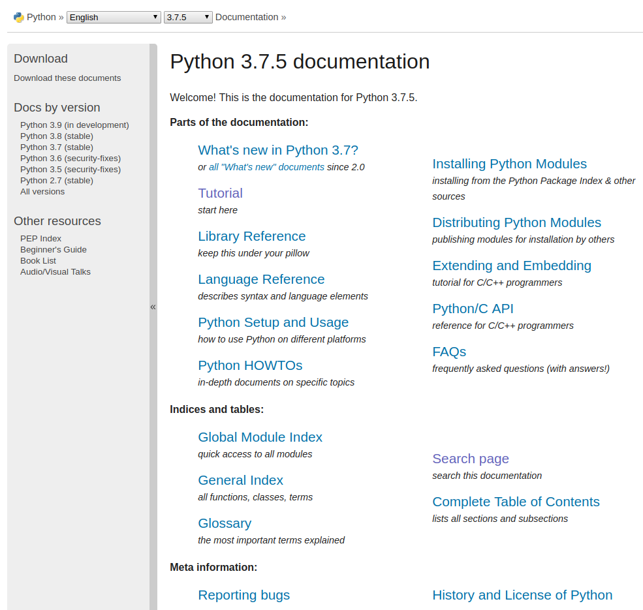
Python documentation
Programming languages come with documentation to help developers get the most out of the language.
Developers very rarely know all the functionality of a language.
Accessing this documentation is commonplace for finding out how to perform a particular function within a language.

Slide 15
Python documentation
The previous piece of code used the random module.
To find out specifically what this module does (plus lots of others and their relating functionality), you can visit the following link:
https://docs.python.org/3.7/

Slide 16
Popular Programming Languages
Notes:
We'll kick things off by exploring some of the most popular programming languages in the industry today. We'll discuss their origins, strengths, weaknesses, and typical use-cases. This will help you make an informed decision when choosing a language for your projects.

Slide 17
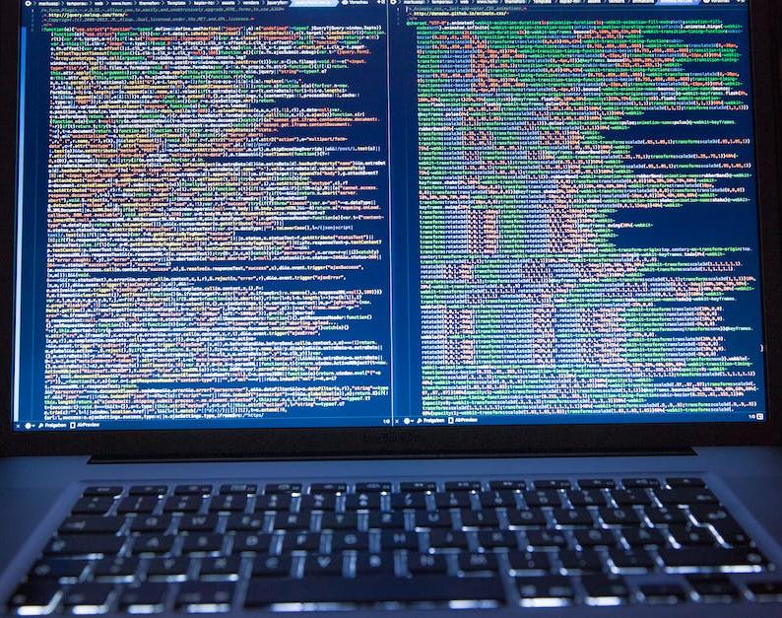
Python
Python is a high-level, interpreted, general-purpose programming language. It is widely used for data science, machine learning, web development, and scripting.
Python is easy to learn and use, and is an excellent choice for beginners.
Python is open source and has a large community of developers.
Notes:
Python, created by Guido van Rossum, is lauded for its readability and ease of use. It's a versatile language, widely used in fields like web development, data analysis, artificial intelligence, and more. Its extensive libraries and frameworks make it a developer's go-to choice.

Slide 18

Java
Java is a general-purpose, object-oriented programming language. It is widely used for enterprise applications, web development, and mobile development.
Java is a mature language with a large community of developers.
Java is platform-independent and can be used on any operating system.
Notes:
Java, developed by Sun Microsystems, is an object-oriented, class-based language. It's highly popular in enterprise-level applications and Android mobile development. Its 'Write Once, Run Anywhere' philosophy makes it incredibly portable across different platforms.

Slide 19

C++
C++ is a general-purpose, object-oriented programming language. It is widely used for high performance computing, game development, and embedded systems.
C++ is a powerful language with a large community of developers.
C++ is platform-independent and can be used on any operating system.

Slide 20
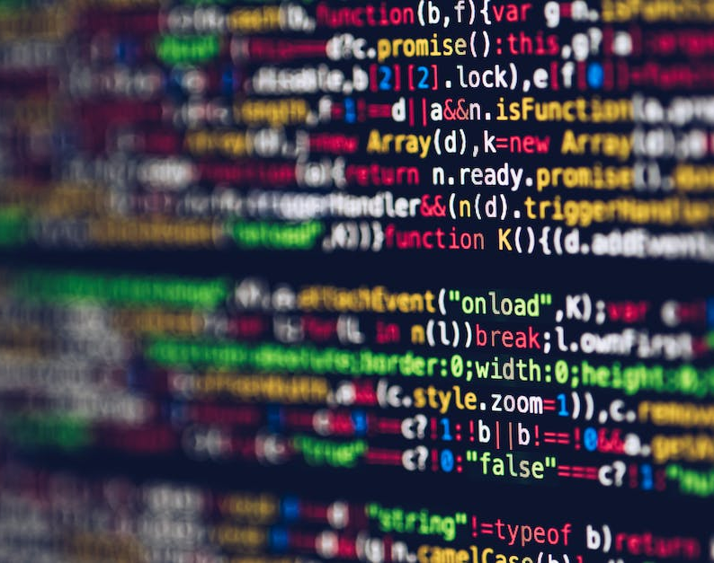
JavaScript
JavaScript is a high-level, interpreted, scripting language. It is widely used for web development, mobile development, and game development.
JavaScript is easy to learn and use, and is an excellent choice for beginners.
JavaScript is open source and has a large community of developers.

Slide 21

C#
C# is a general-purpose, object-oriented programming language. It is widely used for Windows applications, web development, and mobile development.
C# is a powerful language with a large community of developers.
C# is platform-independent and can be used on any operating system.

Slide 22
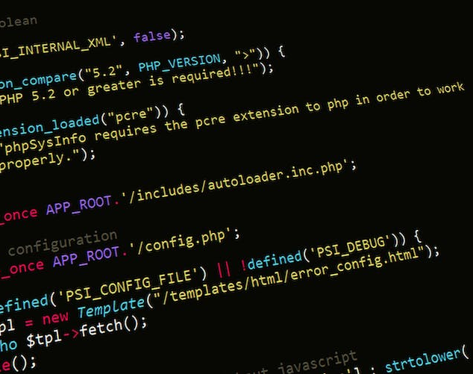
PHP
PHP is a high-level, interpreted, scripting language. It is widely used for web development, mobile development, and game development.
PHP is easy to learn and use, and is an excellent choice for beginners.
PHP is open source and has a large community of developers.

Slide 23
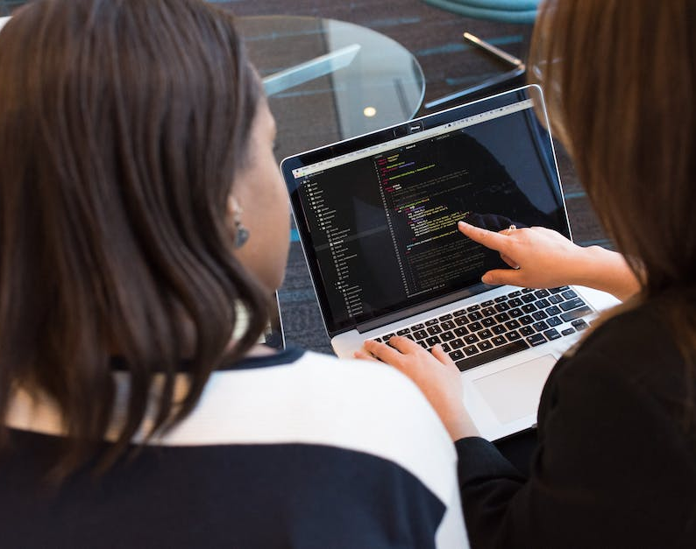
Ruby
Ruby is a high-level, interpreted, scripting language. It is widely used for web development, mobile development, and game development.
Ruby is easy to learn and use, and is an excellent choice for beginners.
Ruby is open source and has a large community of developers.

Slide 24

Swift
Swift is a high-level, interpreted, scripting language. It is widely used for iOS development, mobile development, and game development.
Swift is easy to learn and use, and is an excellent choice for beginners.
Swift is open source and has a large community of developers.
Notes:
There are many popular programming languages to choose from, each with its own strengths and weaknesses.
It is important to choose the right language for your project, based on your needs and the available resources.
No matter which language you choose, there is a large community of developers to help you along the way.

Slide 25
Breakdown the Structure of a Basic Program
Notes:
Now, let's shift our focus to the anatomy of a program. Understanding the basic building blocks like variables, functions, loops, and conditional statements is crucial. These elements serve as the foundation upon which all software is built.

Slide 26
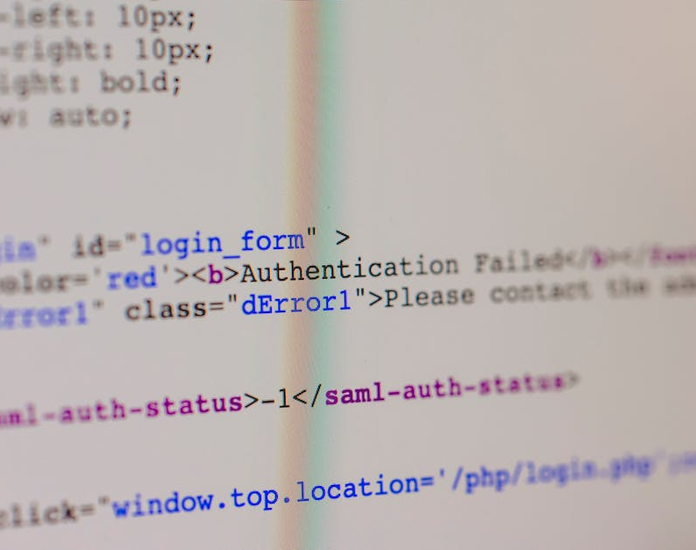
What is a Program?
A program is a set of instructions that a computer follows to perform a task.
It is written in a programming language, such as C++, Java, or Python.
The instructions are written in a way that the computer can understand and execute.
Notes:
A program is made up of several components, including variables, functions, classes, control flow, input and output, and error handling.
These components are used to store data, perform tasks, execute instructions, get data into and out of the program, and handle unexpected situations.
By understanding the structure of a basic program, you can create powerful and efficient programs.

Slide 27

Program Structure
A program is made up of several components, including variables, functions, and classes.
Variables are used to store data, such as numbers or strings.
Functions are used to perform tasks, such as printing a message or calculating a result.
Classes are used to create objects, which are used to store data and perform tasks.
Notes:
Now, let's shift our focus to the anatomy of a program. Understanding the basic building blocks like variables, functions, loops, and conditional statements is crucial. These elements serve as the foundation upon which all software is built.

Slide 28

Variables
Variables are used to store data in a program.
They can be used to store numbers, strings, or other data types.
Variables must be declared before they can be used, and they must be given a name and a data type.

Slide 29
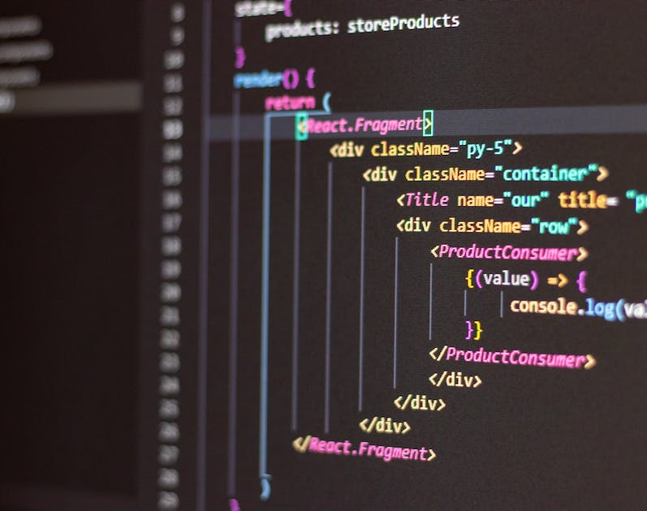
Functions
Functions are used to perform tasks in a program.
They can be used to print a message, calculate a result, or perform any other task.
Functions must be declared before they can be used, and they must be given a name and a list of parameters.

Slide 30

Classes
Classes are used to create objects in a program.
Objects are used to store data and perform tasks.
Classes must be declared before they can be used, and they must be given a name and a list of properties and methods.

Slide 31

Control Flow
Control flow is used to execute instructions in a program.
It is used to determine which instructions are executed and in what order.
Control flow is used to create loops, which are used to repeat instructions, and conditionals, which are used to execute instructions based on certain conditions.

Slide 32
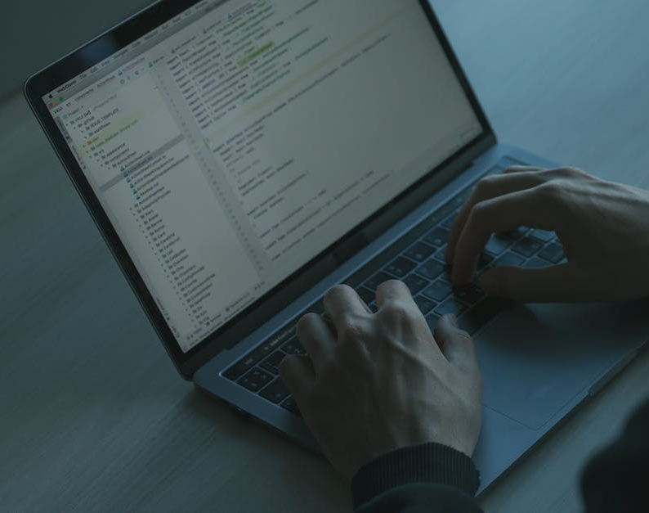
Input and Output
Input and output are used to get data into and out of a program.
Input is used to get data from the user or from a file.
Output is used to display data to the user or to write data to a file.

Slide 33

Error Handling
Error handling is used to handle unexpected situations in a program.
It is used to detect and handle errors, such as invalid input or a missing file.
Error handling is used to ensure that the program continues to run even if an error occurs.
Notes:
Debugging is often considered an art. It's the process of identifying and fixing errors in your code. We'll discuss the different types of errors you might encounter and introduce some tools and techniques for debugging. Mastering this skill can save you countless hours in your development journey.

Slide 34
Debug and Troubleshoot the Program
Notes:
Debugging is often considered an art. It's the process of identifying and fixing errors in your code. We'll discuss the different types of errors you might encounter and introduce some tools and techniques for debugging. Mastering this skill can save you countless hours in your development journey.

Slide 35

What is Debugging?
Debugging is the process of finding and fixing errors in a program.
It is an important part of the software development process.
Debugging can be done manually or with the help of automated tools.
Notes:
Debugging is often considered an art. It's the process of identifying and fixing errors in your code. We'll discuss the different types of errors you might encounter and introduce some tools and techniques for debugging. Mastering this skill can save you countless hours in your development journey.

Slide 36

Types of Errors
Errors can be divided into two categories: syntax errors and logic errors.
Syntax errors are caused by incorrect code, while logic errors are caused by incorrect logic.
It is important to identify the type of error in order to debug the program effectively.

Slide 37

Debugging Techniques
Debugging techniques include using breakpoints, tracing, and logging.
Breakpoints are used to pause the program at a certain point and inspect the state of the program.
Tracing is used to follow the flow of the program and identify where the error is occurring.
Logging is used to record the state of the program at various points in time.

Slide 38

Debugging Tools
Debugging tools are used to automate the debugging process.
These tools can be used to detect errors, analyze the state of the program, and provide suggestions for fixing the errors.
Common debugging tools include debuggers, profilers, and static analysis tools.

Slide 39

Debugging Strategies
Debugging strategies are used to determine the best way to fix an error.
These strategies include trial and error, divide and conquer, and root cause analysis.
It is important to use the right strategy in order to find the most efficient solution.

Slide 40

Testing and Verification
Testing and verification are used to ensure that the error is fixed.
Testing is used to check that the program works as expected, while verification is used to check that the code is correct.
It is important to test and verify the program after fixing an error in order to ensure that the error is truly fixed.

Slide 41

Documentation and Maintenance
Documentation and maintenance are used to prevent future errors.
Documentation is used to record the state of the program and the steps taken to fix the error.
Maintenance is used to keep the program up to date and ensure that it is running correctly.

Slide 42

Debugging Tips
Debugging can be a difficult and time-consuming process.
It is important to use the right tools and strategies in order to make the process easier.
It is also important to take breaks and stay organized in order to stay focused and efficient.
Notes:
Debugging is an essential skill for any software developer.
It is important to understand the different types of errors, tools, and strategies in order to debug a program effectively.
By following these tips, you can become a better and more efficient debugger.

Slide 43
Best Practices for Writing Clean and Efficient Code
Notes:
Writing code is easy; writing good code is challenging. In this section, we'll explore best practices that can make your code not only functional but also clean, efficient, and maintainable. We'll talk about the importance of commenting, naming conventions, reusability, and version control.

Slide 44

Planning Ahead
Planning ahead is essential for writing clean and efficient code.
Organize your code into logical sections and plan out the structure of your code before you start writing.
This will help you avoid writing unnecessary code and make it easier to debug and maintain your code in the future.

Slide 45

Write Readable Code
Write code that is easy to read and understand.
Use descriptive variable names and comments to explain what your code is doing.
This will make it easier for other developers to understand your code and make it easier to debug and maintain in the future.

Slide 46
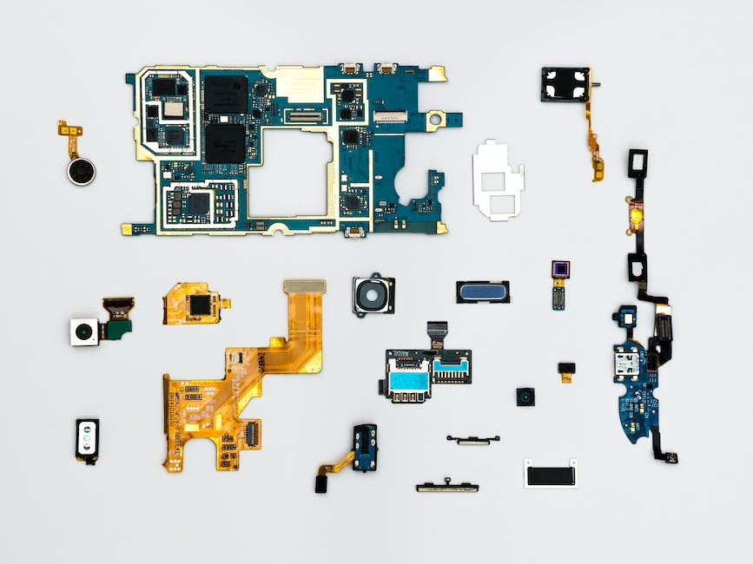
Write Modular Code
Write code that is modular and can be reused in different parts of your program.
Break your code into smaller pieces and create functions and classes to make your code more organized and easier to maintain.
This will make it easier to debug and maintain your code in the future.

Slide 47

Write Testable Code
Write code that is testable and can be easily tested before you deploy it.
Write unit tests to make sure your code is working as expected and create automated tests to make sure your code is working in different environments.
This will help you catch any bugs before you deploy your code and make it easier to maintain in the future.

Slide 48

Write Efficient Code
Write code that is efficient and optimized for performance.
Use data structures and algorithms that are optimized for the task at hand and use caching to reduce the amount of work your code has to do.
This will make your code run faster and make it easier to maintain in the future.

Slide 49

Write Secure Code
Write code that is secure and protected from attackers.
Use secure coding practices to protect your code from malicious attacks and use encryption to protect sensitive data.
This will make your code more secure and make it easier to maintain in the future.

Slide 50

Write Scalable Code
Write code that is scalable and ready for growth.
Design your code to be able to handle an increase in traffic and use cloud services to make it easier to scale your code.
This will make your code more robust and make it easier to maintain in the future.

Slide 51

Document Your Code
Document your code to make it easier to understand.
Write comments to explain what your code is doing and create documentation to explain how to use your code.
This will make it easier for other developers to understand your code and make it easier to maintain in the future.
Notes:
By following these best practices, you can write clean and efficient code that is easy to read, understand, debug, and maintain.
This will make your code more robust and make it easier to work with in the future.

Slide 52
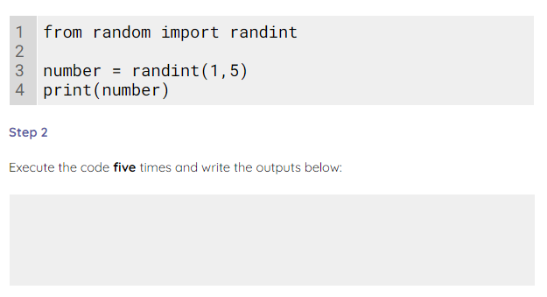
Try it yourself!
Use the activity 1 worksheet to run and investigate this piece of code.
Notes:
A1 Worksheet - Randint

Slide 53
Learning Outcomes
Now you should be able to:
Popular programming languages (e.g., Python, Java).
Breakdown the structure of a basic program.
Debug and troubleshoot the program.
Best practices for writing clean and efficient code.
Understand how to import functions into Python code.

Slide 54

Questions?

Slide 55
Thank You

